Slide 1
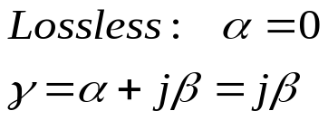
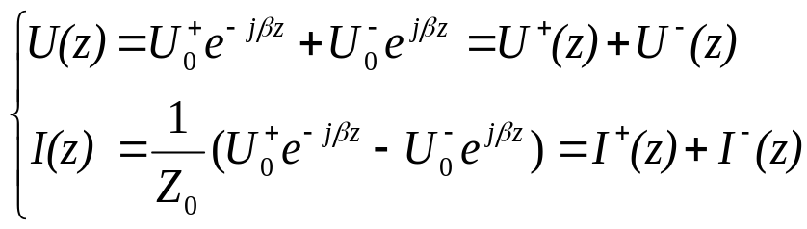
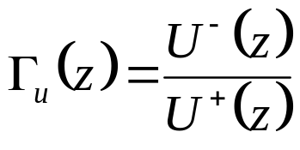
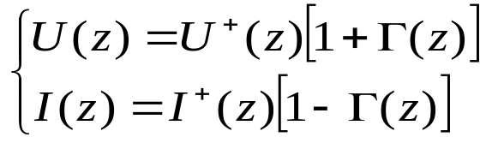

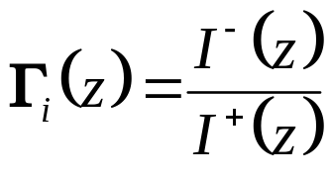

§2.3 Terminated Lossless Transmission Line
1. Three Basic Parameters
U(z), I(z)
Zg
Z₀
Z_{L}
Eg
~
d
z=0
l=0
(1) Voltage reflection coefficient
Default

Slide 2
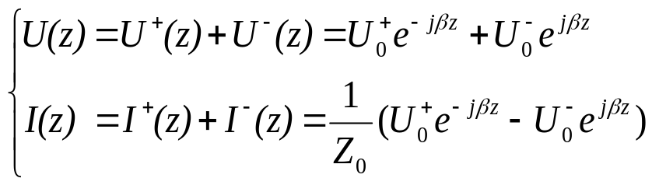
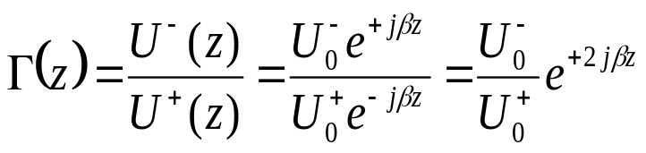

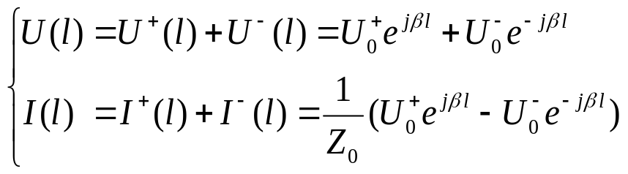
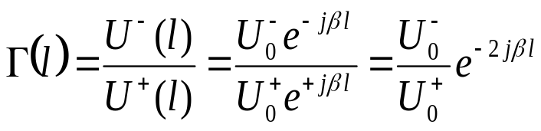

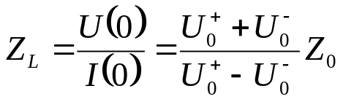
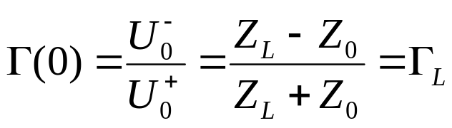
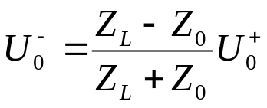
For coordinate: z
U(z), I(z)
Zg
Z₀
Z_{L}
Eg
~
d
z=0
l=0
For coordinate: l

Slide 3
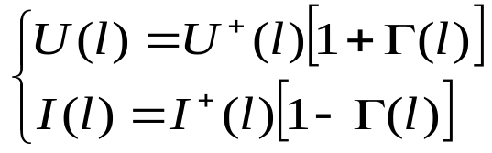

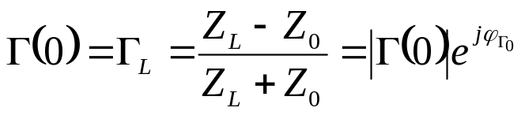
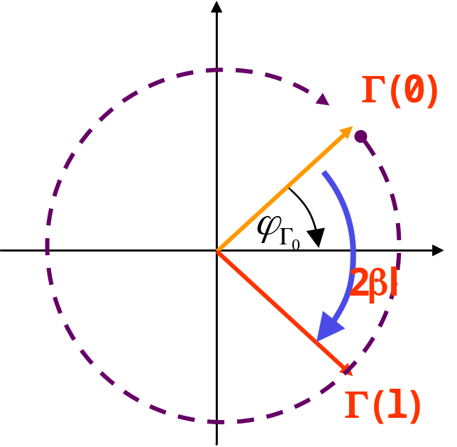
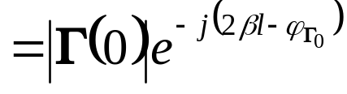
With l and Γ
U(l), I(l)
Zg
Z₀
Z_{L}
Eg
~
d
z=0
l=0

Slide 4
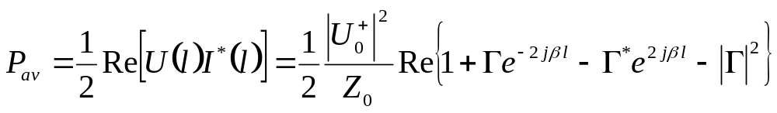
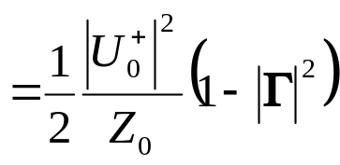
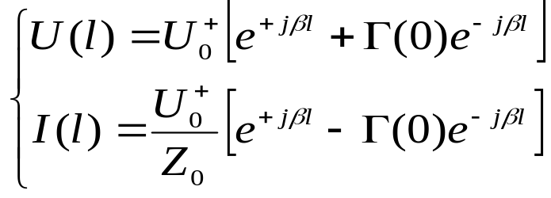

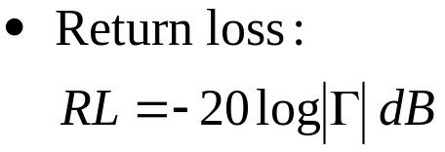
2.3 The terminated lossless TL——three basic parameters
Time-average power flow along the line
Average power flow is constant at any point on the line

Slide 5
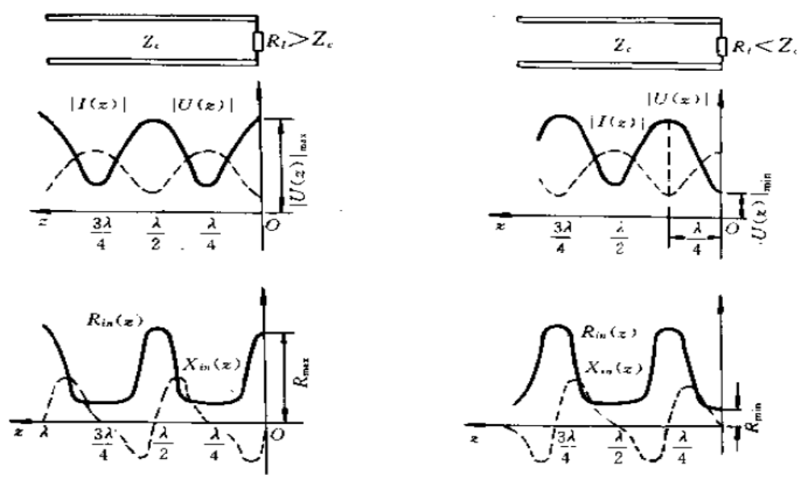


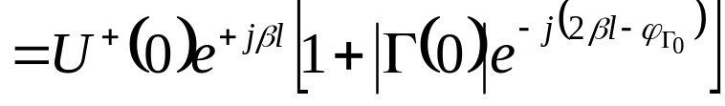
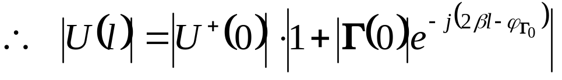

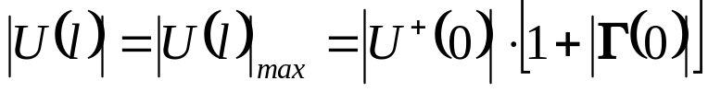

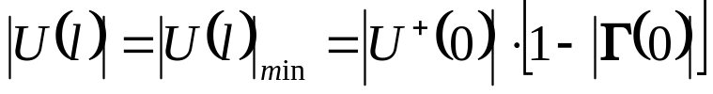
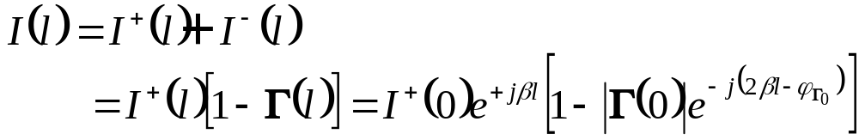

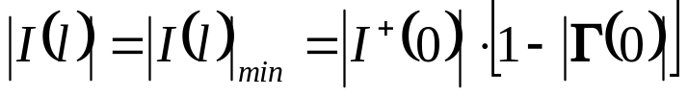
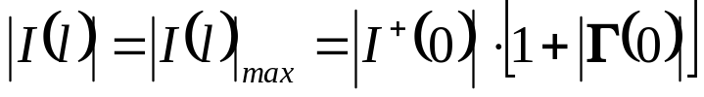
2.3 The terminated lossless TL——three basic parameters

Slide 6
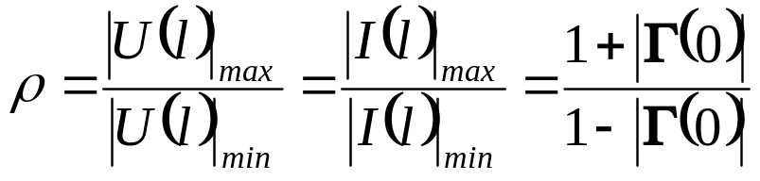
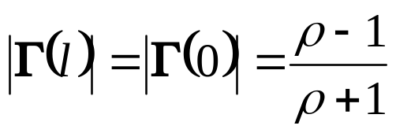

2.3 The terminated lossless TL——three basic parameters
(2) Standing Wave Ratio (SWR) ρ
Voltage standing wave ratio
(VSWR)
0≤|Γ|≤1 ⇒

Slide 7
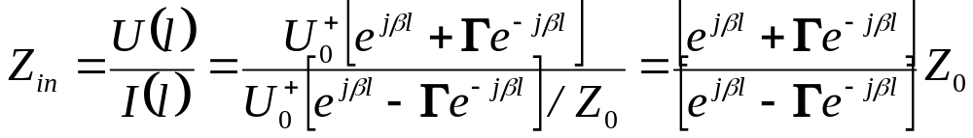
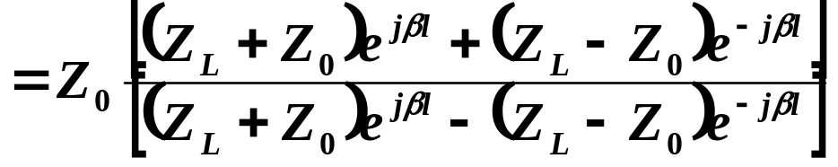
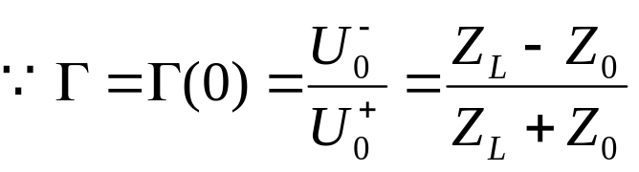
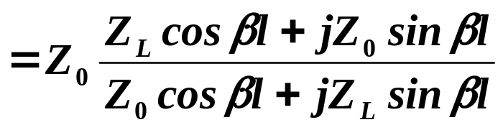
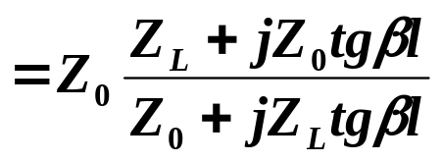
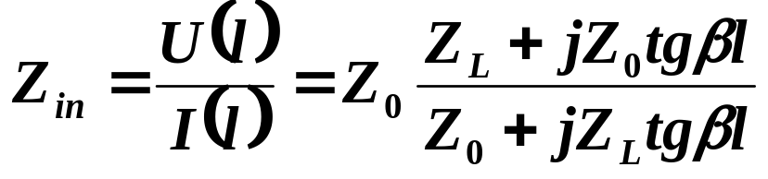
2.3 The terminated lossless TL——three basic parameters
(3) Input impedance Zin
At a distance l from the load, Zin seen looking toward the load is:
Transmission line impedance equation

Slide 8
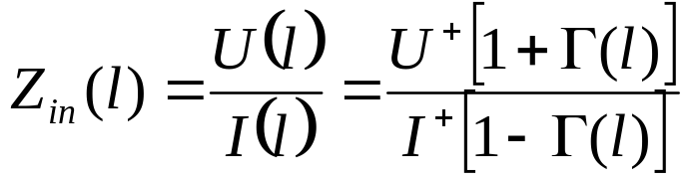
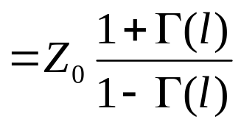
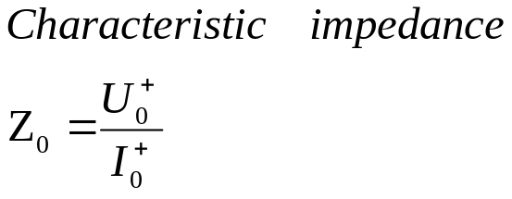
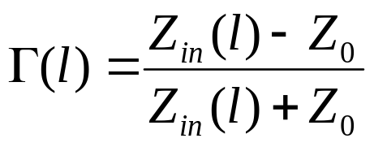

Slide 9
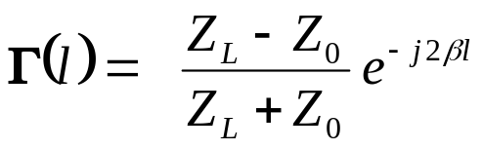


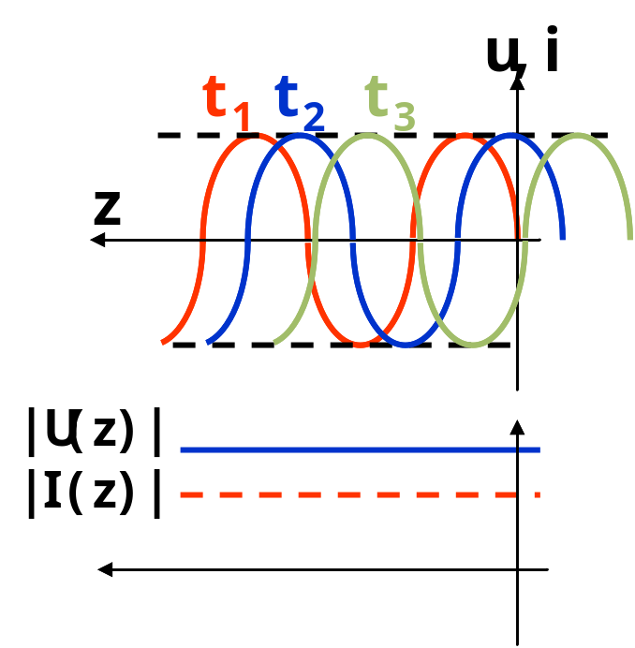
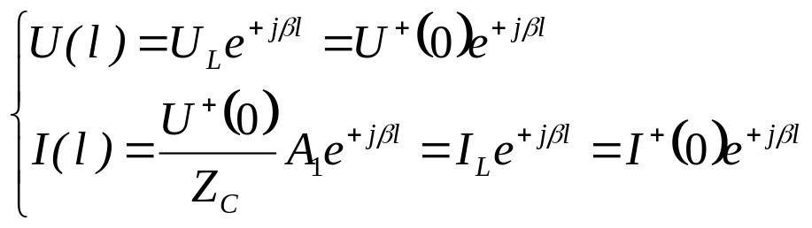
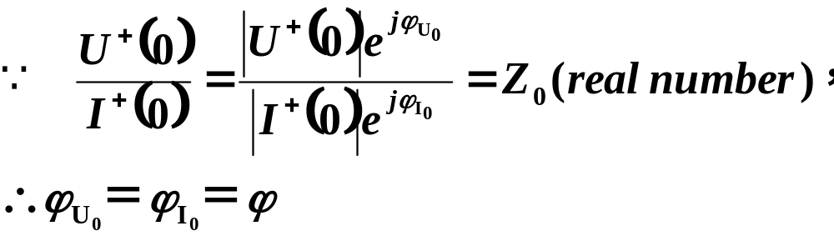
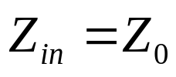
2.3 The terminated lossless TL
2. Special Cases of Lossless Terminated Lines
(1) Z_{L}=Z₀
Traveling wave

Slide 10

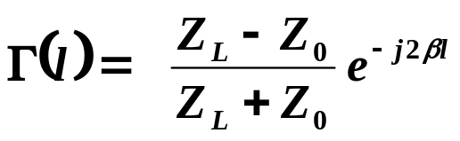
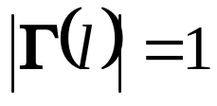
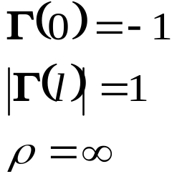

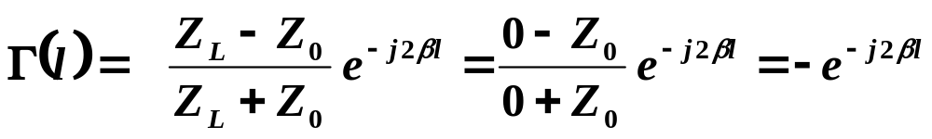

2.3 The terminated lossless TL ——special cases of lossless terminated lines
(2) Z_{L}=0, ∞ ,jX
（a）Terminated in a short circuit

Slide 11
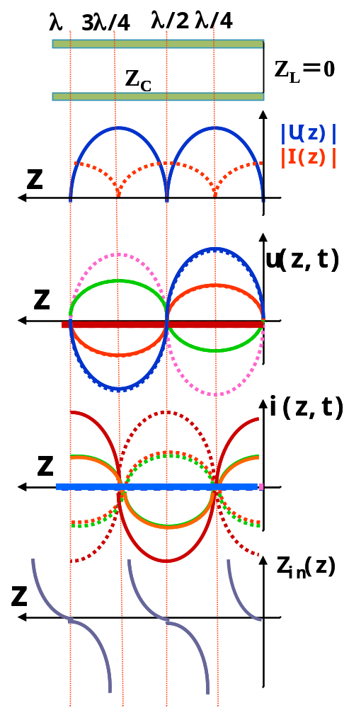




2.3 The terminated lossless TL ——special cases of lossless terminated lines
Input Impedance:

Slide 12







2.3 The terminated lossless TL ——special cases of lossless terminated lines
（b）Terminated in an open circuit

Slide 13



2.3 The terminated lossless TL ——special cases of lossless terminated lines
Time domain
Impedance：

Slide 14









2.3 The terminated lossless TL ——special cases of lossless terminated lines
（c）
complex number
The load can be replaced by a line terminated in a short/open circuit；
For example:
if Z_{L}＝＋jX_{L}，

Slide 15




2.3 The terminated lossless TL ——special cases of lossless terminated lines
Z_{L}＝-jX_{L}

Slide 16




2.3 The terminated lossless TL ——special cases of lossless terminated lines
(3) Z_{L}=R (Resistance)
Generally，Z_{L}＝R_{L}＋jX_{L}，

Slide 17









2.3 The terminated lossless TL ——special cases of lossless terminated lines
Special case，Z_{L}＝R_{L} (Resistance)
if Z_{L}＝R_{L}＝Z₀，(travelling wave)
if R_{L}>Z₀，
if R_{L}<Z_{c}，

Slide 18






2.3 The terminated lossless TL ——special cases of lossless terminated lines
Input Impedance
Z_{L}＝R_{L}＋jX_{L}, Z_{in}＝R_{in}＋jX_{in}
Voltage Maximum
Voltage Minimum

Slide 19




2.3 The terminated lossless TL ——special cases of lossless terminated lines
(4) Terminated transmission lines with some special length
if l = λ/2+nλ
A half-wavelength line (or any multiple of λ /2) does not alter or transform the load impedance, regardless of the characteristic impedance.
if l = λ/4+nλ/2
Such a line is known as a quarter-wave transformer
λ/2 repeater ; λ/4 transformer

Slide 20







2.3 The terminated lossless TL ——special cases of lossless terminated lines
3. Decibels and Nepers
The ratio of two power levels is expressed in decibels
The ratio of voltage is expressed in nepers:
If we let P2=1mW, then P1 can be expressed in dBm as:

